Slide 1
Linked Data & Semantic Web
Fernando Aguilar Gómez
CSIC (+SKILLS4EOSC fellowship)

Slide 2
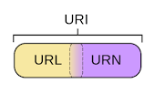
Some concepts
HTTP Protocol
Persistent Identifiers (PIDs) – URI (Uniform Resource Identifier)
Metadata
Formats: XML, HTML, JSON
Fernando Aguilar | Linked Data | 29/10/24

Slide 3
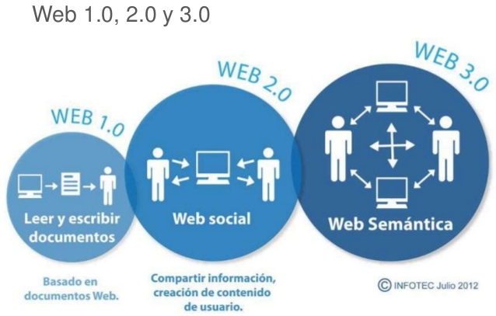

Slide 4
WWW history (I)
First communication between a client and a server using the HTTP protocol in November 1989 (Tim Berners-Lee, CERN).
WEB: HTTP, HTML, URL
Web 1.0 is the original Internet. It allowed reading from the network.
The dynamic part: hyperlinks linking pages to other pages (network, web).
The Web was understood as an information portal.
Tables with positions to align the elements on the page.

Slide 5
WWW history (II)
On this new platform, users have the ability to control their data.
Bidirectional
Content generated by the webmaster and the user.
Anyone can create content: comments, documents, videos...
More dynamism: databases, direct interaction with the user.
Web 2.0: three concepts... (next)

Slide 6
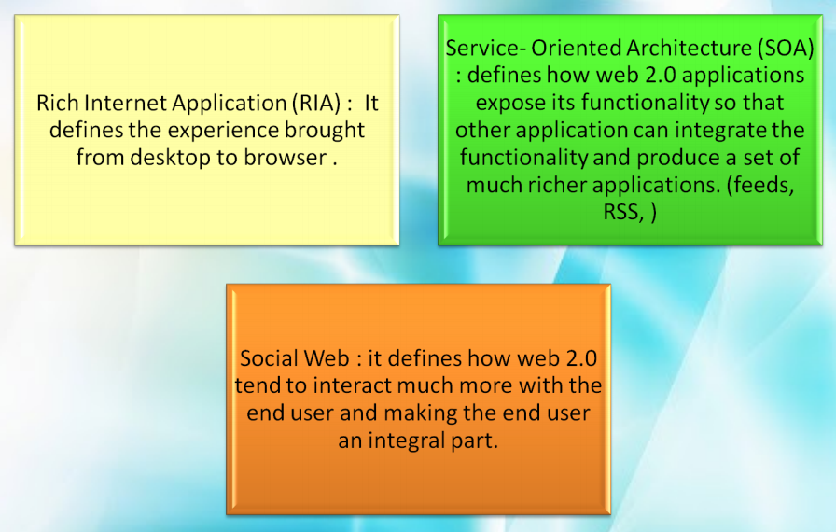
Web 2.0 concepts

Slide 7
Web 3.0 - Semantic Web
The Semantic Web: WWW extension that seeks to give meaning and context to data
Goal: enable machines to understand and process information more intelligently.
Key principles of the Semantic Web include:
Interoperability: It facilitates the integration and exchange of data between different systems and applications. Machine-actionable
Knowledge representation: Uses ontologies and controlled vocabularies to represent domain knowledge in a formal and explicit way.
Inference: Allows automatic inferences on data using logical rules and relationships defined in ontologies. New knowledge from existing data.

Slide 8


Slide 9
Linked data
Linked Data is a set of best practices for publishing, sharing and connecting data on the web in a structured and linked way.
Proposed by Tim Berners-Lee. Extension of the principles of the original web with the goal of making data more interconnected and accessible to machines and humans.
The fundamental principles:
URIs: Each entity or resource must have a globally unique identifier in the form of a URI (Uniform Resource Identifier).
HTTP: URIs must resolve through the HTTP protocol, which facilitates the retrieval of information about the resource via the web.
RDF: Information about resources should be represented using the RDF (Resource Description Framework) language, which provides a standard model for describing resources and their relationships in form of subject-predicate-object triples.
RDF links: Data should include links to other related resources via URIs to enable navigation and interconnection between data.

Slide 10
Semantic web as a component of web 3.0
URI
Uniform Resource Identifier
RDF
Resource Description Framework
RDFS
RDF Schema
OWL
Web Ontology Language
Microformat

Slide 11
URI
Uniform resource identifier (URI) is the way to identify all content points, regardless if they are a page, a text, a video, mp3, gif or a program. Digital resource.
It is used to identify the resource. Without URI, we cannot talk about semantic web.
The most common form of a URI is the address of a web page, set in a certain way: URL or Uniform Resource Locator.
A URI describes:
The mechanism for accessing the resource
The server where it is hosted

Slide 12
RDF
Resource Description Framework (RDF) of the World Wide Web Consortium (W3C) is a set of specifications originally designed for metadata models.
This framework is used to represent data in the “cloud” LOD (linking open data), LD, as XML files among other formats.
It is also a way to define resources using a particular framework.
LOD: Linked Open Data. Data in the LOD cloud is open and freely accessible. Free in the sense that the data can be created and modified by the users themselves.
Protegé...

Slide 13
RDFS
RDF Schema (Resource Description Framework Schema, variously abbreviated as RDFS, RDF(S), RDF-S, or RDF/S)
A set of classes with certain properties using the “extensible knowledge representation language” RDF
Provides basic elements for describing ontologies
Defines RDF structures, relationships, elements, etc.
Semantic Extension RDF.

Slide 14
OWL - Ontology Web Language
Ontologies define the terms used to describe and represent an area of knowledge.
Used by people and machines share certain information under a domain (for example, an area of knowledge, such as medicine).
OWL (Web Ontology Language) is designed to be used by applications that need to process information content instead of just presenting information to humans.
A relationship schema is defined for specific cases (e.g., in science or for specific business applications, such as e-commerce).

Slide 15
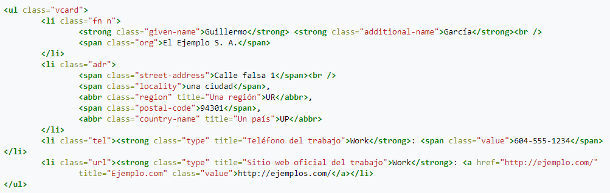
Microformats
Microformats are small HTML patterns for representing published entities such as people, events, tags…
Simplest and fastest way to provide an API to your web information.
Try to solve simple problems by adapting to usage patterns
Example: embedding relevant information on your website, for bots…
http://microformats.org/wiki/h-card

Slide 16
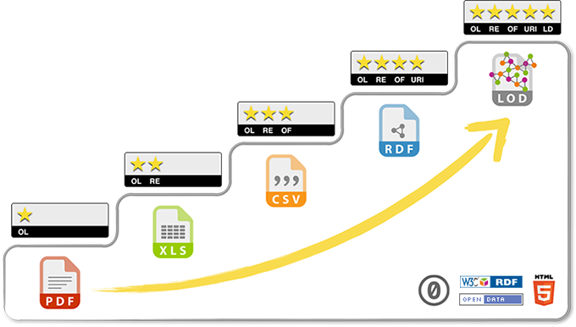
Open Data 5 stars
Tim Berners-Lee, the inventor of the Web and initiator of Linked Data, suggested a 5-star development scheme for Open Data.
5 levels ranging from the lowest to the highest level of interoperability or semantic capability
http://5stardata.info/es/

Slide 17
Open Data 5 stars
★ Publish your data on the Web (in any format) and under an open license
★★Publish as structured data (e.g. Excel instead of a scanned table image)
★★★Use non-proprietary formats (e.g. CSV instead of Excel)
★★★★ Use URIs to denote things, so people can point to them
★★★★★ Link your data to other data to provide context

Slide 18


Slide 19
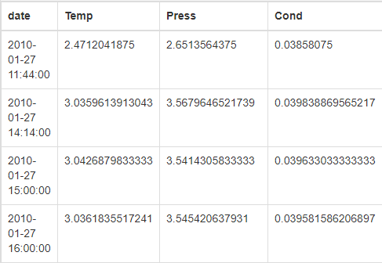
CSV Vs. RDF
Matadata:
DC: Author, Title, etc.
EML: Administrative, Contextual, Structural.
Attributes
Project
Data
Metadatos:
DC: Author (URI, type:Person), Title.
EML: Administrative, Contextual, Structural.
Attributes (type:Press, Unit)
Project (type:project fundedBy EC …)
Linked Data & Controlled Vocabularies
Data (Machine – Human)
Searches: data from the same project, datasets with the same attributes, similar projects...

Slide 20




Semantic web – Linked Data

Slide 21
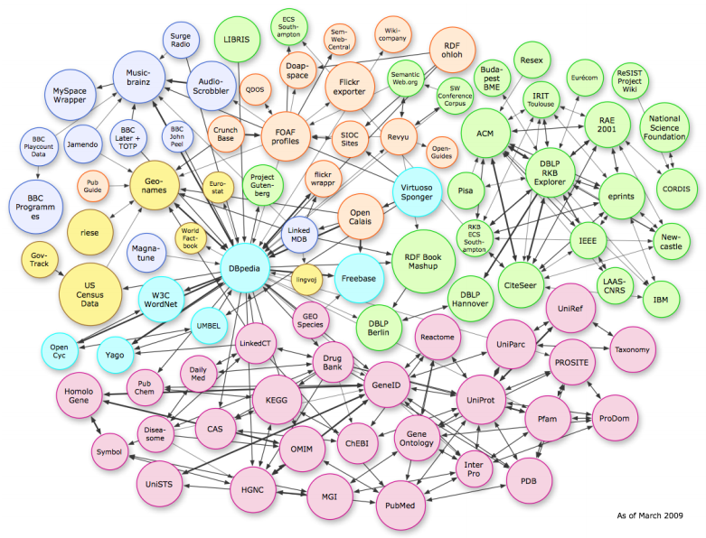

Slide 22
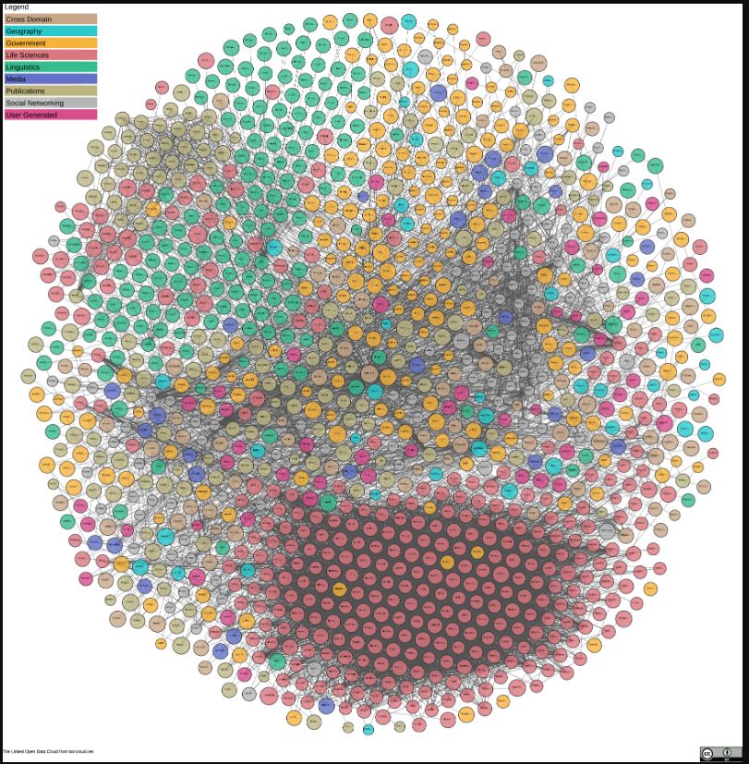

Slide 23
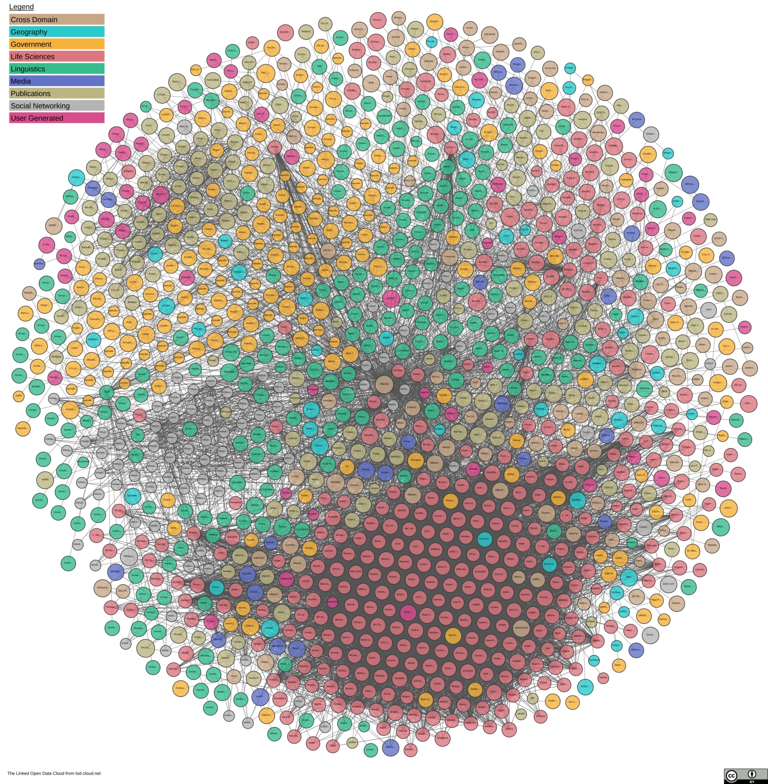
April 2019

Slide 24
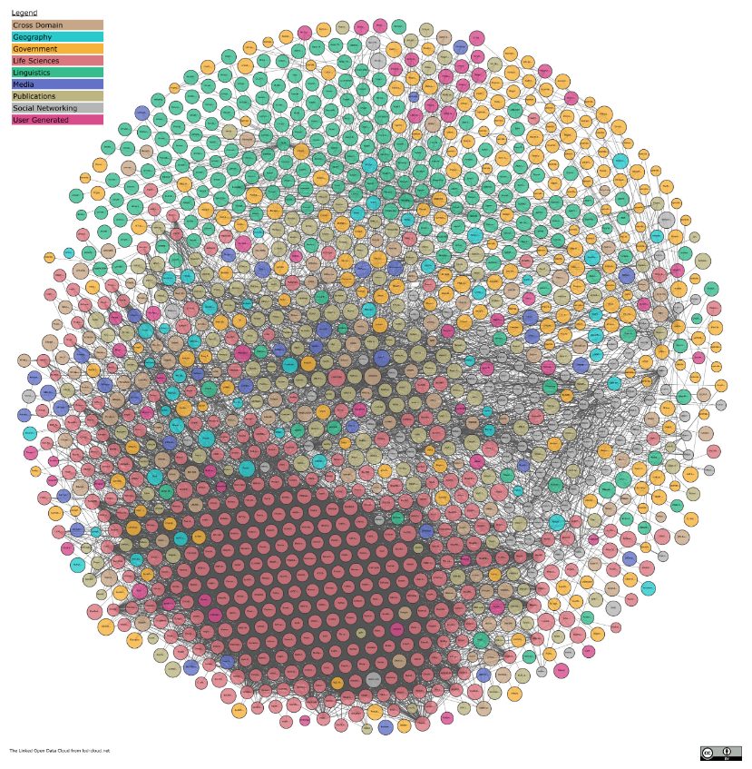
2021

Slide 25
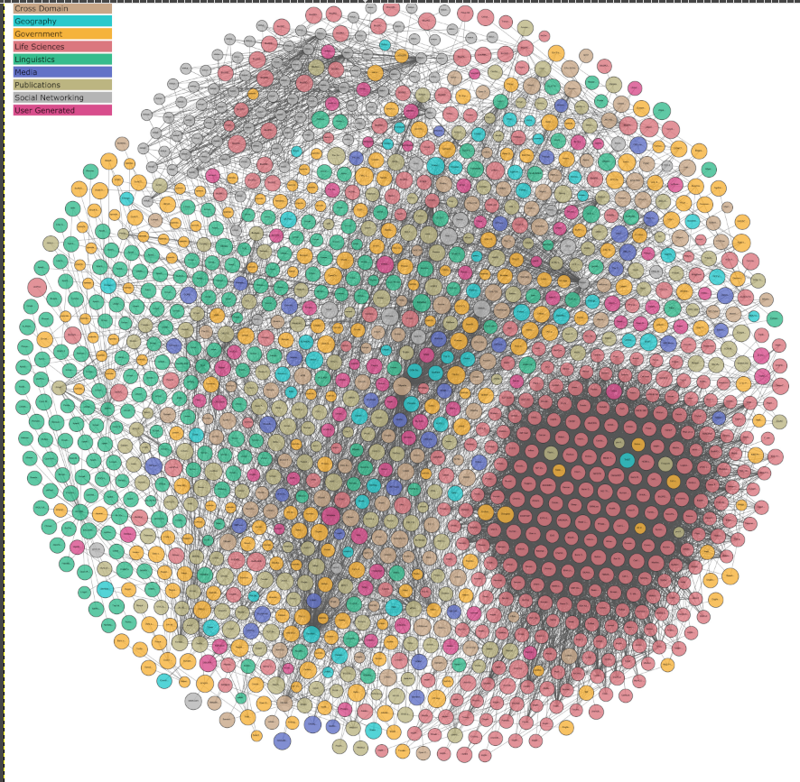
2023

Slide 26
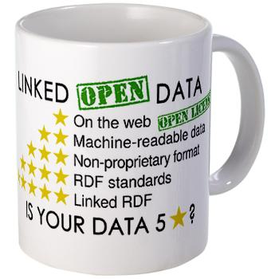
4 Linked data basic rules
Use URIs to name resources.
Use HTTP URIs to make those names searchable.
When someone searches for a URI, provide useful information using standards (RDF, SPARQL, Metadata).
Include links to other URIs, so that more resources can be discovered.
HTTP + URIs + RDF = Web of Data

Slide 27
Name things with URIs
Use URI instead of URN (Uniform Resource Name) and DOIs
Separate the URI representing the real object or concept from its description
Example
Real Person
http://www.esciencedatafactory.com/people/yann_le_franc
Description RDF (for machines)
http://www.esciencedatafactory.com/people/yann_le_franc.rdf
Description HTML (for humans)
http://www.esciencedatafactory.com/people/yann_le_franc.html

Slide 28
The RDF Data Model
Resource A
URI
Relation
URI
Resource B
URI
My website
http://www.example.com/index.html
Me
http://myprofile/name
Created by
RDF Triple
(subject, predicate, object)

Slide 29
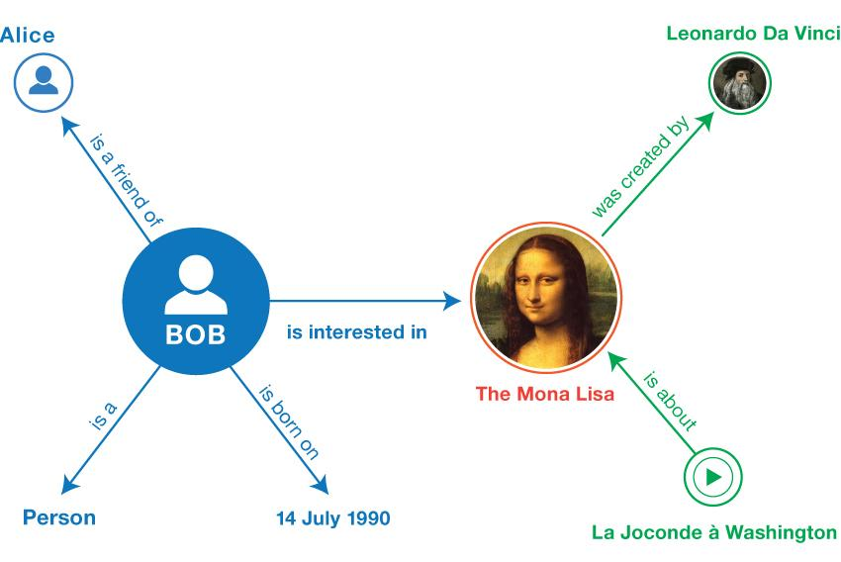
RDF in action
Labeled directed graph
From W3C RDF 1.1. Primer https://www.w3.org/TR/rdf11-primer/

Slide 30
Applications
https://permid.org/onecalaisViewer
“Branded the Bob Dylan of Brazil, Caetano Veloso co-founded Tropicalia, the progressive poetry, theater and music movement that helped define Latin America's psychedelic '60s. Alongside his fellow conspirator, Gilberto Gil, Veloso fused Bossa Nova, African rhythms, and acid-drenched acoustic guitar with a political consciousness that found him censored, banned, incarcerated and eventually exiled by the country's military dictatorship. The recipe was complex but simple: melodies as gorgeous as a Copacabana beach layered atop of a philosophical wit exposing his homeland's most gross imbalances.”
IMDB: https://www.imdb.com/title/tt3581920/
og:… What can we find? (Open Graph Protocol)

Slide 31
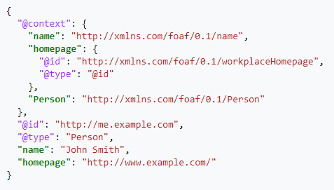
JSON Linked Data (-LD)
JSON-LD, or JavaScript Object Notation for Linked Data, is a method of encoding linked data using JSON.
One of its goals was to require as little effort as possible from developers to transform their existing JSON into JSON-LD.
This allows data to be serialized in a way that is similar to traditional JSON.

Slide 32
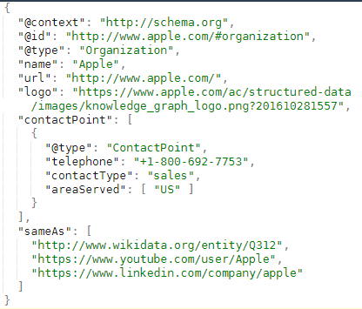
Embed LD JSON (in HTML)
<script type="application/ld+json">
</script>

Slide 33
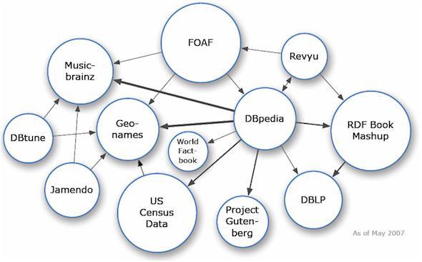
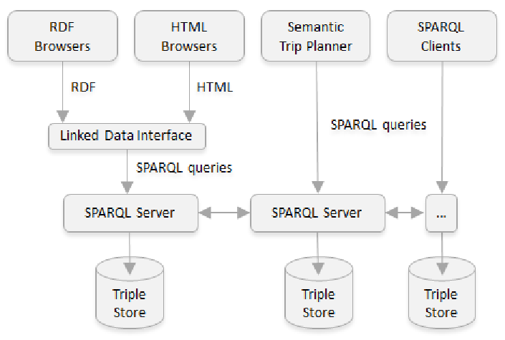
Interconnections

Slide 34
Challenges and trends
Interoperability: Although Linked Data promotes interoperability, there are still technical challenges in integrating heterogeneous data and aligning ontologies.
Data Quality: Ensuring the quality and accuracy of linked data remains a challenge, especially in environments where data may be dispersed and of unknown origin.
Scalability: Handling large volumes of linked data and efficiently querying this data poses challenges in terms of performance and scalability.
Adoption and Awareness: Despite its benefits, the adoption of Linked Data and Semantic Web is often hampered by lack of awareness, resources and technical capabilities in organizations.
Trends...?
Integration with Artificial Intelligence: The integration of Linked Data and Semantic Web with artificial intelligence techniques, such as machine learning and natural language processing, will open new opportunities for understanding and analyzing data on the web.
Rich Data Web: The evolution towards a rich data web, where data is not only linked, but also enriched with contextual and semantic information, will drive new forms of interaction and knowledge discovery.

Slide 35
SPARQL
Fernando Aguilar

Slide 36
SPARQL
Recursive acronym: SPARQL Protocol and RDF Query Language
Standardized language for querying RDF graphs.
Standardized by the RDF Data Access Working Group (DAWG) of the World Wide Web Consortium (W3C).
Like SQL, query language. A search engine and data warehousing are required.
SQL (Language) - MySQL (Engine)
SPARQL (Language) - Virtuoso (Engine)
http://vos.openlinksw.com/owiki/wiki/VOS/VOSSparqlProtocol
Results can be sets (tables) or RDF networks.

Slide 37
Tips for queries
To understand what an ontology is
To know the existing relationships
To know the schemas used
Distinguish between the data itself and the classes.
Search classes and instances to know the relationships of an object

Slide 38
Basic Query
PREFIX – Namespaces
SELECT – Attributes you want to query and get as response
WHERE – Conditions to fulfil

Slide 39
Basic Query - Example 1
List of Films in DBpedia
PREFIX – Namespaces
SELECT – Attributes you want to get
WHERE – Conditions to fulfil
PREFIX dbo: <http://dbpedia.org/ontology/>
PREFIX foaf: <http://xmlns.com/foaf/0.1/>
SELECT ?film
WHERE{
?film a dbo:Film .
} LIMIT 100
a = rdf:type

Slide 40
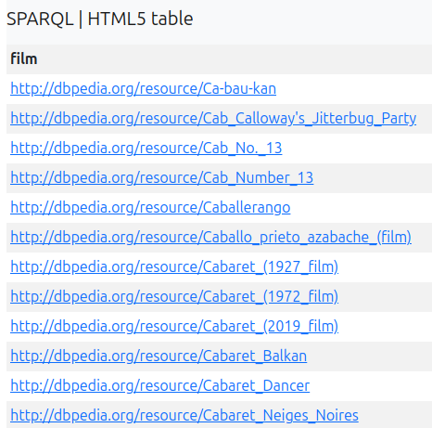
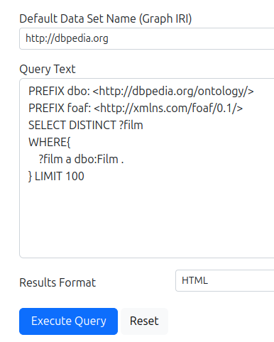
Basic Query - DBpedia endpoint
List of Films in DBpedia
https://dbpedia.org/sparql
URIs… Names?

Slide 41
Basic Query - Example 2
List of Films in DBpedia
PREFIX – Namespaces
SELECT – Attributes you want to get
WHERE – Conditions to fulfil
PREFIX dbo: <http://dbpedia.org/ontology/>
PREFIX foaf: <http://xmlns.com/foaf/0.1/>
SELECT ?title
WHERE{
?film a dbo:Film .
?film foaf:name ?title
} LIMIT 100
a = rdf:type

Slide 42
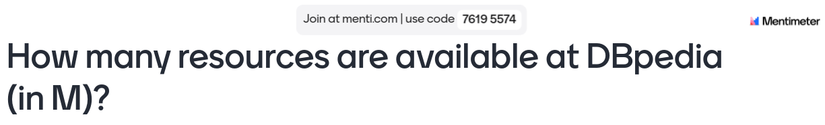

Slide 43
Basic Query - Example 3
Director per film
PREFIX dbo: <http://dbpedia.org/ontology/>
PREFIX foaf: <http://xmlns.com/foaf/0.1/>
SELECT DISTINCT ?director
WHERE{
?film ?a dbo:Film .
?film dbo:director ?director .
} LIMIT 100

Slide 44
Basic Query - Example 4
Birthdate of directors
PREFIX dbo: <http://dbpedia.org/ontology/>
PREFIX foaf: <http://xmlns.com/foaf/0.1/>
SELECT DISTINCT ?director ?bd
WHERE{
?film ?a dbo:Film .
?film dbo:director ?director .
?director dbo:birthDate ?bd .
} LIMIT 100

Slide 45
Basic Query - Example 5
Birth place of directors
PREFIX dbo: <http://dbpedia.org/ontology/>
PREFIX foaf: <http://xmlns.com/foaf/0.1/>
SELECT DISTINCT ?director ?bp
WHERE{
?film a dbo:Film .
?film dbo:director ?director .
?director dbo:birthPlace ?bp .
} LIMIT 100

Slide 46
Basic Query - Example 6
Birth place of directors. FILTER: only cities < 10000 inhabitants
PREFIX dbo: <http://dbpedia.org/ontology/>
PREFIX foaf: <http://xmlns.com/foaf/0.1/>
SELECT DISTINCT ?director ?bp
WHERE{
?film a dbo:Film .
?film dbo:director ?director .
?director dbo:birthPlace ?bp .
?bp dbo:populationTotal ?population .
FILTER (?population < 10000)
} LIMIT 100

Slide 47
Basic Query - Example 7
Birth place of directors. FILTER: only cities < 10000 inhabitants
Birthdate: What I missed?
PREFIX dbo: <http://dbpedia.org/ontology/>
PREFIX foaf: <http://xmlns.com/foaf/0.1/>
SELECT DISTINCT ?director ?bp
WHERE{
?film a dbo:Film .
?film dbo:director ?director .
?director dbo:birthPlace ?bp .
?bp dbo:populationTotal ?population .
FILTER (?population < 10000)
} LIMIT 100

Slide 48
Thank you! Questions?
Fernando Aguilar Gómez
f.a [at] CSIC.es
To cite this presentation, please copy and paste: <Surname, Name. (Date). Pres title, occasion of the presentation. Link to presentation in Skills4EOSC community on Zenodo>

